Slide 1



Lesson #04
Decision Trees
and more...
October, 2020

Slide 2
Table of Contents
Introduction to Decision Tree
Splitting Tree (Entropy & Gini)
Evaluating Classifiers
Applying Decision Trees
Get data
Data cleaning & preprocessing
Train & Test
Hyperparameter tuning
Improve

Slide 3
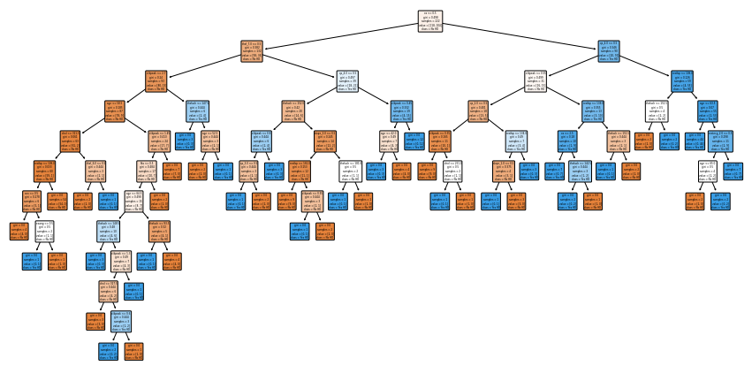
How can a dataset be represented as a tree?
@statquest

Slide 4
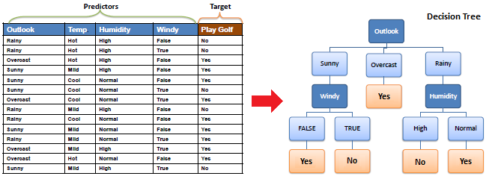
Decision Tree (classification)
@Rishabh Jain

Slide 5
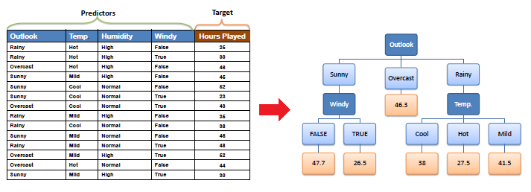
Decision Tree (regression)
@Rishabh Jain
Notes:
Jogar golf
O grande desafio aqui é fazer isso de maneira automatica

Slide 6


Slide 7
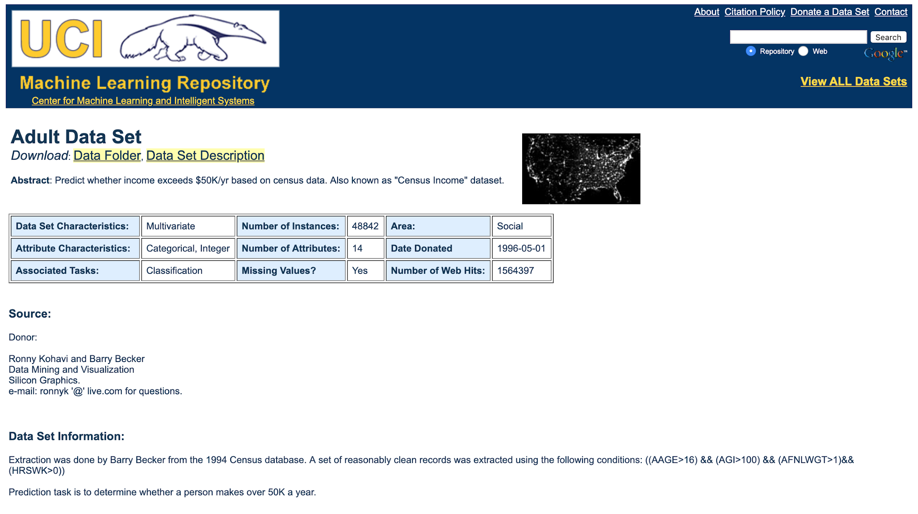
Notes:
Dado veio do censo de 1994
Problema de classificação

Slide 8
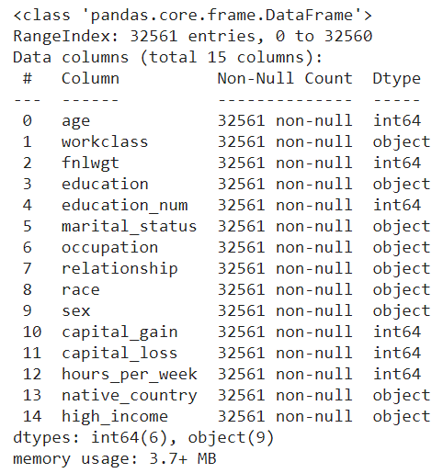
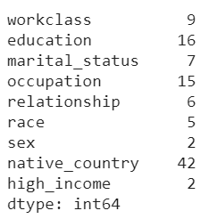
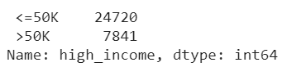
Cardinality
Notes:
data.select_dtypes("object").apply(pd.Series.nunique)
https://github.com/pooja2512/Adult-Census-Income/blob/master/Adult%20Census%20Income.ipynb
Boa prática: classe majoritaria [0] e classe minoritaria [1] isso auxilio as métricas de avaliação, só por isso

Slide 9
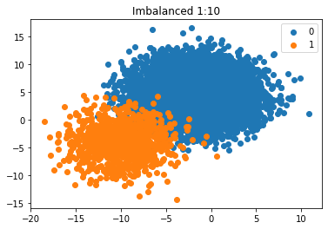
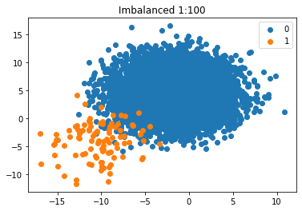
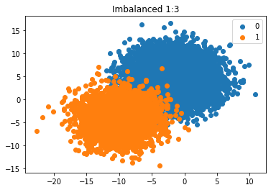
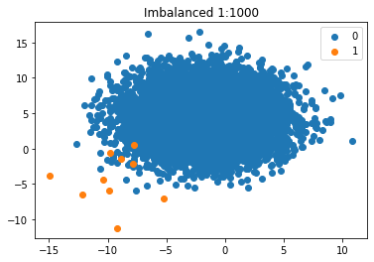

Slide 10
How can we split the tree?
Algorithm used in Decision Trees
ID3 (Entropy)
Gini Index
Chi-Square
Reduction in Variance
C4.5, pruning
What income do people make?
Do they work in the Private sector?
Notes:
Vamos focar nas duas primeiras.

Slide 11

Entropy
Entropy is an indicator of how messy your data is.

Slide 12
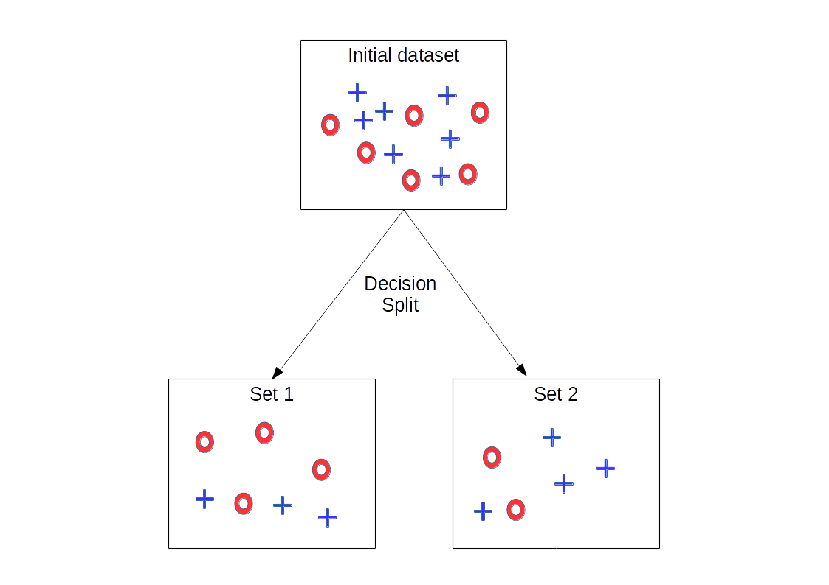
Why Entropy in Decision Trees?
Decrease the entropy
The goal is to tidy the data.
You try to separate your data and group the samples together in the classes they belong to.
You maximize the purity of the groups as much as possible each time you create a new node of the tree
Of course, at the end of the tree, you want to have a clear answer.

Slide 13
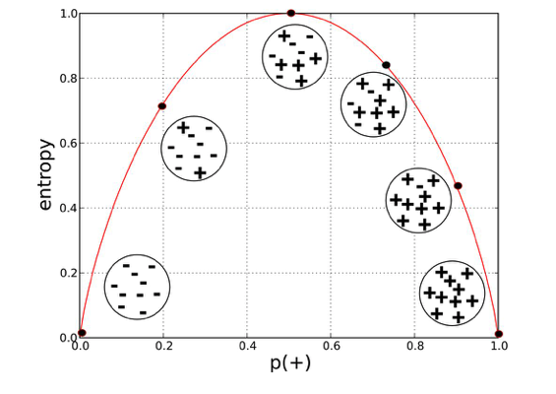
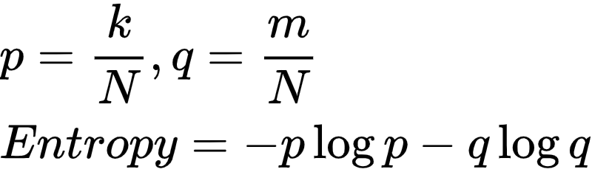
Mathematical definition of entropy
Suppose a set of N items, these items fall into two categories:
[+] gain > 50k (k)
[- ] gain <= 50k (m)
Notes:
Nesse exemplo supomos que existe apenas duas classes (0,1)
Quando se tem apenas N itens (q=0, p=1) ou apenas m itens (q=1 e p=0) a entropia é zero (tudo bem organizado)
A entropia é máxima quando p=0.5 e q=0.5
Dependendo do número de classes a Entropia pode ser maior que 1

Slide 14
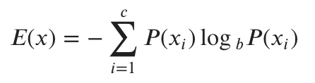
Generalization
Feature X
P(x_{i}) is the fraction of examples in a given class i
entropy(df.high_income.value_counts(),base=2) 0.7963839552022132
Notes:
C = os valores unicos, no nosso caso high_income é [0,1]
A entropia de uma dava coluna
Dependendo do número de classes a entropia pode ser maior que 1. Mas em geral é [0,1] from scipy.stats import entropy

Slide 15
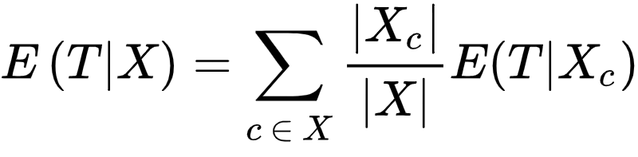
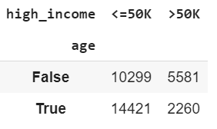
Entropy using the frequency table of two attributes
 |  | High Income
 |  | <=50k | >50k
Age | <= 37 | 14421 | 2260 | 16681 (51.22%)
 | > 37 | 10299 | 5581 | 15880 (48.77%)
cross = pd.crosstab(data.age <= data.age.median(), data.high_income)
0.4877 * entropy(cross.iloc[0],base=2) + 0.5122 \ * entropy(cross.iloc[1],base=2) 0.7492980618394182
Notes:
A entropia E(T,X) de T (alvo) em relação a X. Pode ser entendida como a entropia de T ponderada por X
Quando menor esse valor melhor será a divisão por essa coluna

Slide 16
Information Gain
The information gain is based on the decrease in entropy after a dataset is split on an attribute.
Constructing a decision tree is all about finding attribute that returns the highest information gain (i.e., the most homogeneous branches).
IG(T,X) = E(T) - E(T|X)
Information Gain from X on T
Notes:
Ganho de informação é deixar homogeneo, ou seja, apenas uma classe!!! Uma classe é a informação.
Basicamente isso pode ser interpretado assim. Dado o meu alvo (T), no caso a columa "Income". Qual será o meu ganho de informaçÃo se eu dividir a árvore por X.

Slide 17
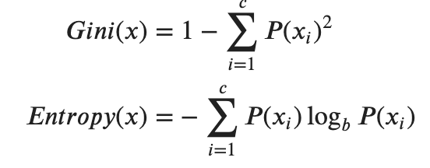
Gini index or Entropy is the criterion for calculating Information Gain. Both of them are measures of impurity of a node.
Notes:
Na prática os resultados são bem parecidos

Slide 18
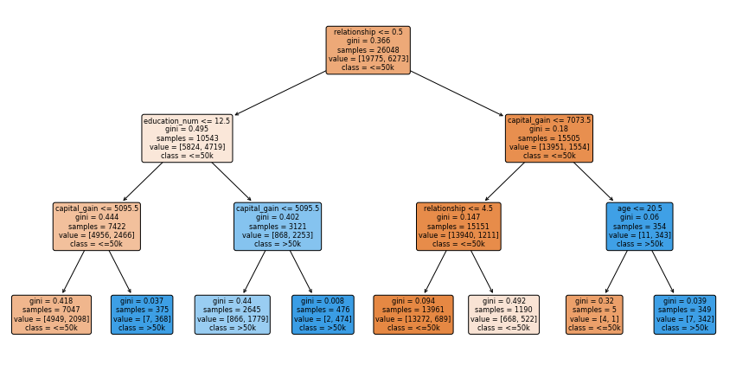
from sklearn.tree import plot_tree

Slide 19
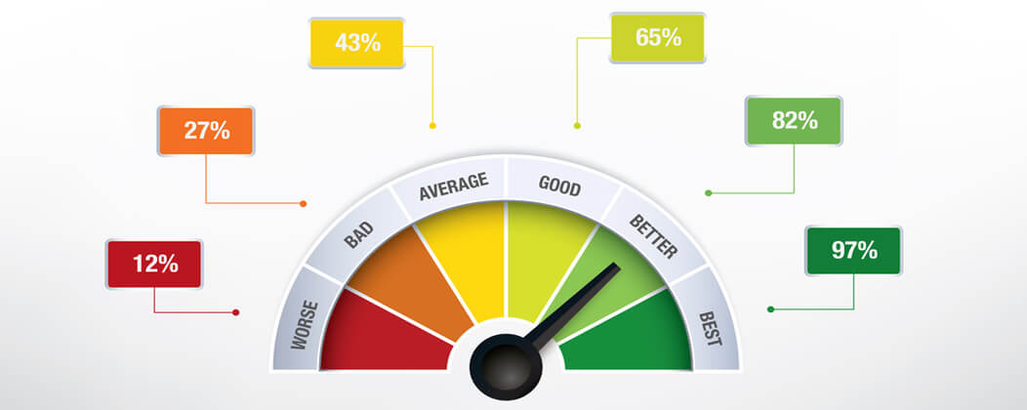
Evaluating Classifiers
A classier is only as good as the metric used to evaluate it
Threshold metrics
Ranking metrics
Probability metrics
Notes:
We can divide evaluation metrics into three useful groups; they are:
1. Threshold Metrics
2. Ranking Metrics
3. Probability Metrics.
These are the threshold metrics (e.g.,
accuracy and F-measure), the ranking methods and metrics (e.g., receiver operating
characteristics (ROC) analysis and AUC), and the probabilistic metrics (e.g., root-
mean-squared error).
‘

Slide 20
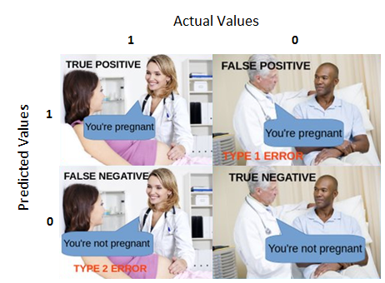
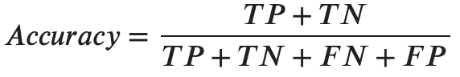
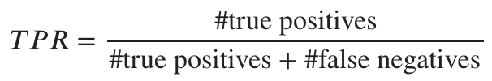
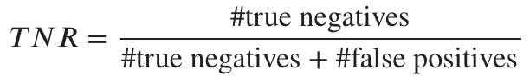
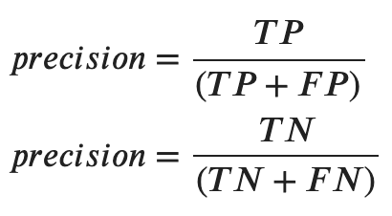
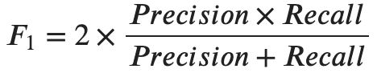
Threshold Metrics are those that quantify the classification prediction errors
Recall
Notes:
<boa pratica>
Classe 0 - classe majoritaria
Casse 1 - classe minoritaria
Ainda tem outras métricas (gmean, f-Beta)

Slide 21
from sklearn.metrics import accuracy_score from sklearn.metrics import classification_report from sklearn.metrics import confusion_matrix
classification_report(y_test,predict) precision recall f1-score support 0 0.86 0.95 0.90 4945 1 0.77 0.50 0.60 1568 accuracy 0.84 6513 macro avg 0.81 0.73 0.75 6513 weighted avg 0.84 0.84 0.83 6513
accuracy_score(y_test, predict) 0.8432366037156457
confusion_matrix(y_test,predict) array([[4712, 233], [ 788, 780]])
confusion_matrix(y_test,predict, labels=[1,0]) array([[ 780, 788], [ 233, 4712]])
confusion_matrix(predict,y_test, labels=[1,0]) array([[ 780, 233], [ 788, 4712]])

Slide 22
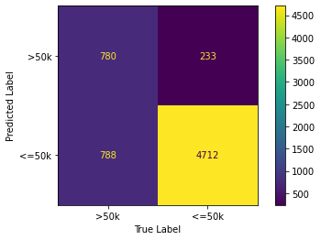
from sklearn.metrics import plot_confusion_matrix from sklearn.metrics import ConfusionMatrixDisplay
ConfusionMatrixDisplay(confusion_matrix(predict,y_test,labels=[1,0]), display_labels=[">50k","<=50k"]).plot(values_format=".0f",ax=ax)

Slide 23
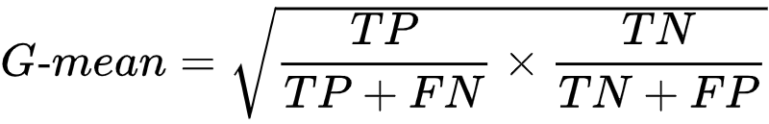
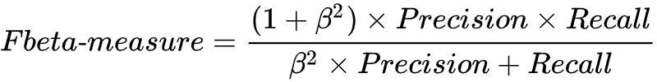
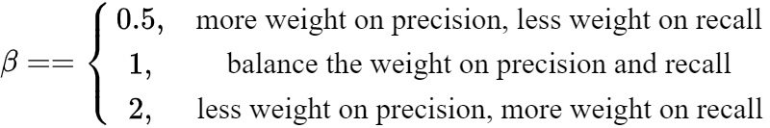
Additional Threshold Metrics
Notes:
G-mean é muito usado para problemas com classes desbalanceadas
Fbeta é a generalização do F-measure. O beta controla os pesos da média harmónica

Slide 24
Ranking Metrics for Classifier Evaluation
Rank metrics are more concerned with evaluating classifiers based on how effective they are at separating classes.
These metrics require that a classifier predicts a score or a probability of class membership. Therefore, instead of a simple positive or negative prediction, the score introduces a level of granularity.

Slide 25
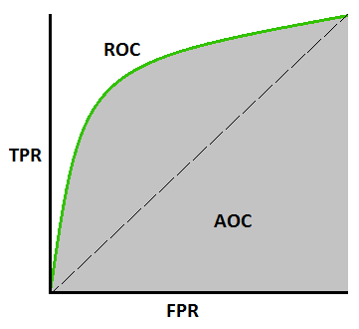
Receiver Operating Characteristic (ROC)
TPR
(measure the impact of True Positive)
FPR = 1 - TNR
(measure the impact of False Positive)
AUC - Area Under Curve
Notes:
Quanto maior por o AUC sobre o ROC melhor. Na prática, quanto mais próximo de 1 melhor.
Ainda é possível usar um gráfico muito similar com Recall vs Precision (o melhor ponto seria uper-right)

Slide 26
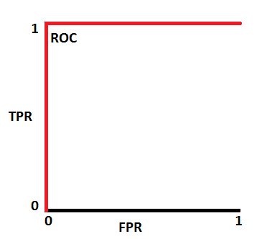
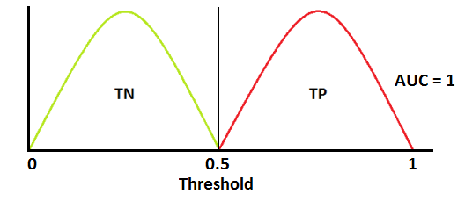
How to speculate the performance of model?
Notes:
Abaixo de 0.5 é classe negativa e acima é classe positiva

Slide 27
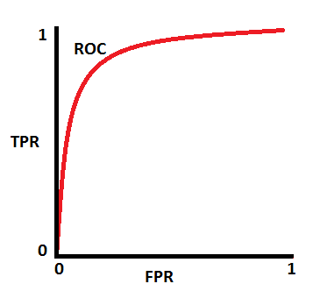
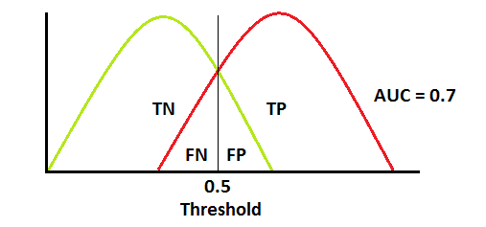
How to speculate the performance of model?
Notes:
Abaixo de 0.5 é classe negativa e acima é classe positiva

Slide 28
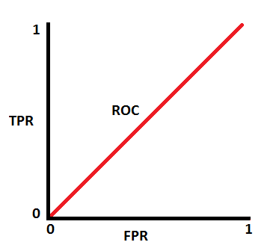
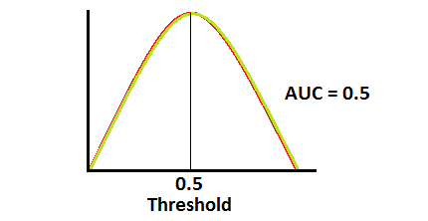
How to speculate the performance of model?
Notes:
Abaixo de 0.5 é classe negativa e acima é classe positiva

Slide 29
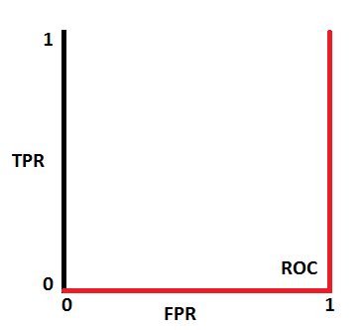
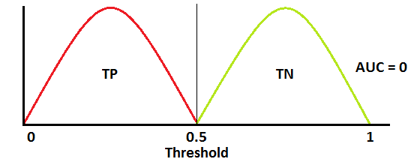
How to speculate the performance of model?
Notes:
Abaixo de 0.5 é classe negativa e acima é classe positiva
https://towardsdatascience.com/a-walk-through-imbalanced-classes-in-machine-learning-through-a-visual-cheat-sheet-974740b19094

Slide 30
Probabilistic Metrics for Classifier Evaluation
Probabilistic metrics are designed specially to quantify the uncertainty in a classier's predictions. These are useful for problems where we are less interested in incorrect vs. correct class predictions and more interested in the uncertainty the model has in predictions and penalizing those predictions that are wrong but highly condent.
Notes:
Muito utilizado em funções custo de DL

Slide 31
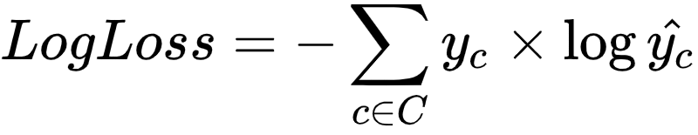
Cross-entropy
The score summarizes the average difference between two probability distributions. A perfect
classifier has a log loss of 0.0, with worse values being positive up to infinity.
The score can be generalized to multiple classes by simply adding the terms:

Slide 32
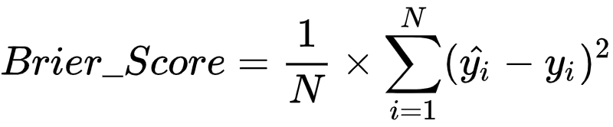
Brier Score
Another popular score for predicted probabilities is the Brier score. The benefit of the Brier score is that it is focused on the positive class, which for imbalanced classification is the minority class. This makes it more preferable than log loss, which is focused on the entire probability distribution.
Notes:
A perfect classier has a Brier score of 0.0. Although typically described in terms of binary
classication tasks, the Brier score can also be calculated for multiclass classication problems.

Slide 33
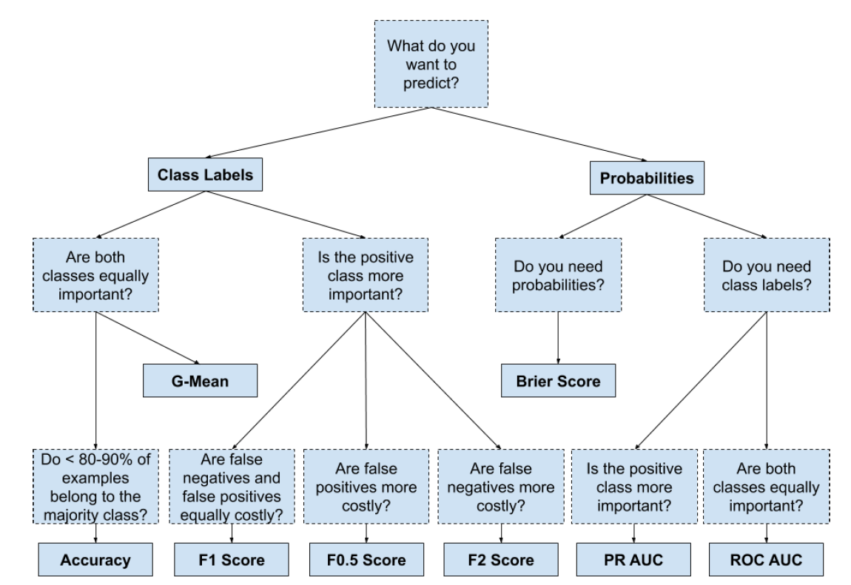
How to Choose an Evaluation Metric?
@jason brownlee

Slide 34

scikit-learn 0.23

Slide 35
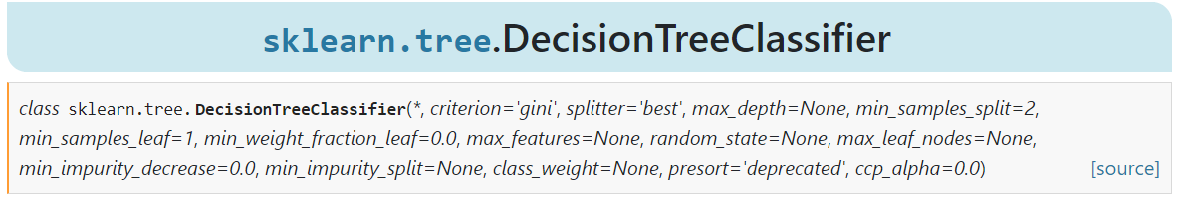
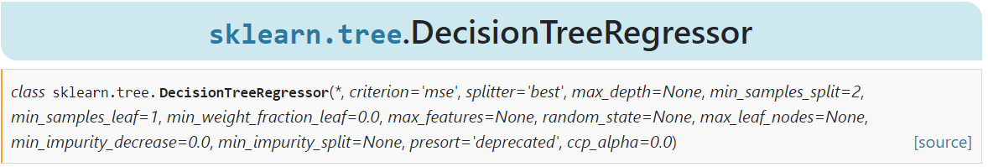
Applying Decision Trees

Slide 36

A general ML workflow
Notes:
Load Libraries
Get data, including EDA
Clean, prepare and manipulate Data (feature engineering)
Modeling (train and test)
Algorithm Tuning
Finalizing the Model

Slide 37
A general ML workflow
Load Libraries
Get data, including EDA
Clean, prepare and manipulate data (feature engineering)
Modeling (train and test)
Algorithm Tuning
Finalizing the Model

Slide 38
import pandas as pd import numpy as np import seaborn as sns import matplotlib.pyplot as plt from sklearn.neighbors import LocalOutlierFactor from sklearn.model_selection import train_test_split from sklearn.preprocessing import LabelEncoder from sklearn.preprocessing import OneHotEncoder from sklearn.neighbors import KNeighborsClassifier from sklearn.pipeline import Pipeline from sklearn.model_selection import StratifiedKFold from sklearn.tree import DecisionTreeClassifier from sklearn.model_selection import GridSearchCV from sklearn.metrics import accuracy_score from sklearn.metrics import classification_report from sklearn.metrics import confusion_matrix from sklearn.metrics import plot_confusion_matrix from sklearn.metrics import ConfusionMatrixDisplay from sklearn.tree import plot_tree import joblib
Load Libraries

Slide 39
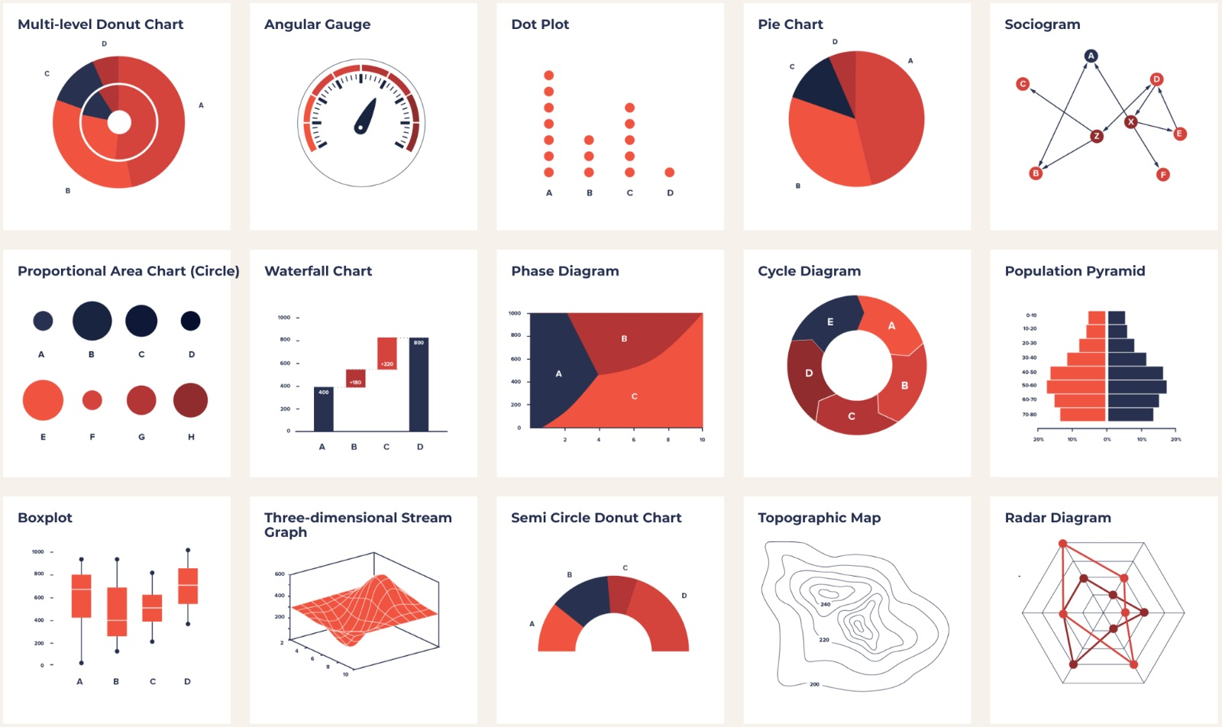
EXPLORATORY DATA ANALYSIS (EDA)

Slide 40
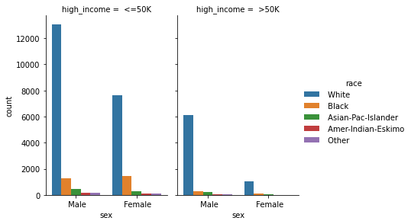
g = sns.catplot(x="sex", hue="race", col="high_income", data=income, kind="count", height=4, aspect=.7)
Notes:
Tudo isso é para detectar que realmente algumas colunas podem influenciar nos resultados

Slide 41
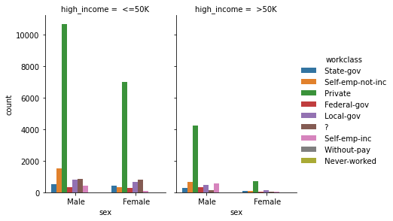
g = sns.catplot(x="sex", hue="workclass", col="high_income", data=income, kind="count", height=4, aspect=.7)

Slide 42
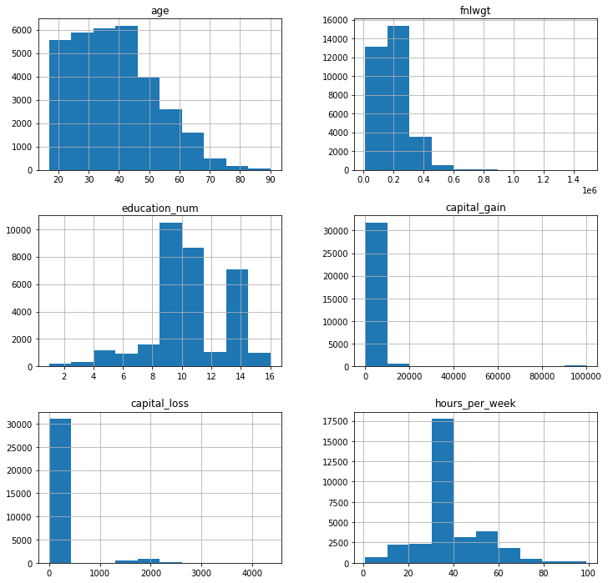
fig, ax = plt.subplots(1,1,figsize=(12,12)) income.hist(ax=ax) plt.show()
Notes:
As variaveis tem uma assimetria para a direita

Slide 43

CLEAN, PREPARE AND MANIPULATE DATA

Slide 44
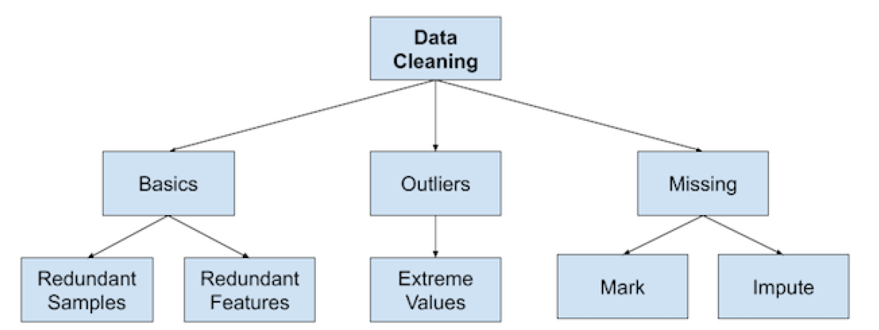
Overview of Data Cleaning
df.drop_duplicates() df.duplicated()
from sklearn.neighbors import LocalOutlierFactor from sklearn.ensemble import IsolationForest
from sklearn.impute import SimpleImputer from sklearn.impute import KNNImputer
Notes:
Reforçar as técnicas de outliers:
IQR 99.7%
3desvios padrões 99.7%
NDimensões (sklearn)
Outras

Slide 45
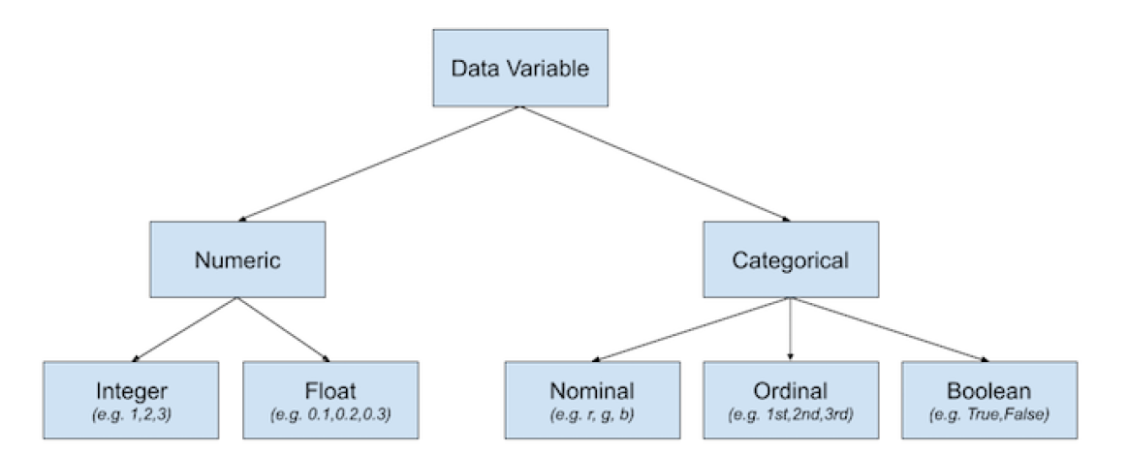
Overview of Data Variable Types

Slide 46


Slide 47



Overview of Data Transforms

Slide 48
# data x = income.select_dtypes("int64") y = np.where(data["high_income"] == ' <=50K',0,1) # standardize the dataset scaler = MinMaxScaler() x = scaler.fit_transform(x) # split into train and test sets x_train, x_test, y_train, y_test = train_test_split(x, y, test_size=0.3, random_state=1) # fit the model model = DecisionTreeClassifier() model.fit(x_train,y_train) # evaluate the model yhat = model.predict(x_test) accuracy_score(y_test,yhat) 0.7723410789231242
Wrong way!!!!
Notes:
Dessa forma estamos vazando dados do treinamento para o teste

Slide 49
# data x = income.select_dtypes("int64") y = np.where(data["high_income"] == ' <=50K',0,1) # split into train and test sets x_train, x_test, y_train, y_test = train_test_split(x, y, test_size=0.3, random_state=1) # standardize the train dataset scaler = MinMaxScaler() x_train = scaler.fit_transform(x_train) # scale the test dataset x_test = scaler.transform(x_test) # fit the model model = DecisionTreeClassifier() model.fit(x_train,y_train) # evaluate the model yhat = model.predict(x_test) accuracy_score(y_test,yhat) 0.7734670897737742
Right
way!!!!
Notes:
O vazamento de dados é ainda mais dificil de detectar se vc estiver usando k-fold, porém utilizando pipelines resolve o problema

Slide 50
# data x = data.select_dtypes("int64") y = np.where(data["high_income"] == ' <=50K',0,1) # split into train and test sets x_train, x_test, y_train, y_test = train_test_split(x, y, test_size=0.3, random_state=1) # identify outlier in the training dataset lof = LocalOutlierFactor() outlier = lof.fit_predict(x_train) mask = outlier != -1 # select all rows that are not outliers x_train, y_train = x_train[mask], y_train[mask] # standardize the train dataset scaler = MinMaxScaler() x_train = scaler.fit_transform(x_train) # scale the test dataset x_test = scaler.transform(x_test) # fit the model model = DecisionTreeClassifier() model.fit(x_train,y_train) # evaluate the model yhat = model.predict(x_test) accuracy_score(y_test,yhat) 0.7632306274951377
Outlier removal without data leakage

Slide 51
Train and Test
# split-out train/validation and test dataset x_train, x_test, y_train, y_test = train_test_split(income.drop(labels="high_income",axis=1), income["high_income"], test_size=0.30, random_state=0, shuffle=True, stratify=income["high_income"])

Slide 52
Hyperparameter Tuning
# create a pipeline pipe = Pipeline([("classifier", DecisionTreeClassifier())]) # create a dictionary with the hyperparameters search_space = [{"classifier":[DecisionTreeClassifier()], "classifier__criterion": ["gini","entropy"]}, {"classifier": [KNeighborsClassifier()], "classifier__n_neighbors": [5,7]}] # create grid search kfold = StratifiedKFold(n_splits=10,random_state=0,shuffle=True) # see other scoring # https://scikit-learn.org/stable/modules/model_evaluation.html#scoring-parameter grid = GridSearchCV(estimator=pipe, param_grid=search_space, cv=kfold, scoring="accuracy", n_jobs=-1) # fit grid search best_model = grid.fit(x_train,y_train)

Slide 53


Performance Evaluation

Slide 54
Knowing when to use decision trees
The main advantages of using decision trees is that they're:
Easy to interpret
Relatively fast to fit and make predictions
Able to handle multiple types of data
Able to pick up nonlinearities in data, and usually fairly accurate
The main disadvantage of using decision trees is their tendency to overfit.

Slide 55

Lesson #04 - Decision Trees.ipynb
Data Transforms using numerical data
Hyperparameter tuning (multiples eval. metrics?)
Analysing overfitting (eval using train dataset)
Personalize pipeline
Feature selection
Other models using Ensemble - RandomForest?

